Slide 1


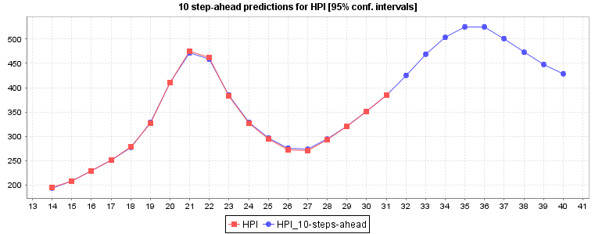
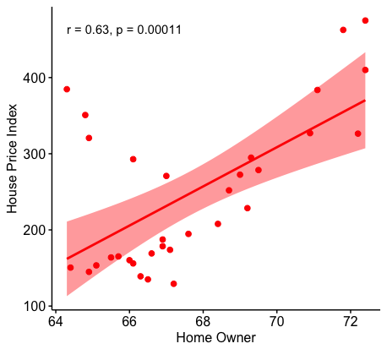
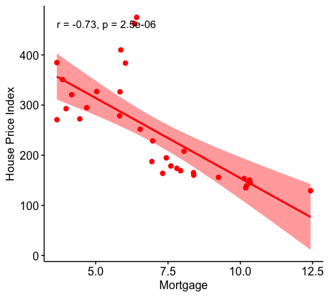
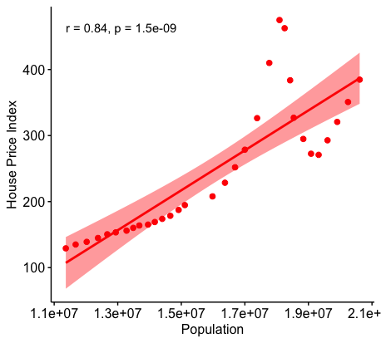
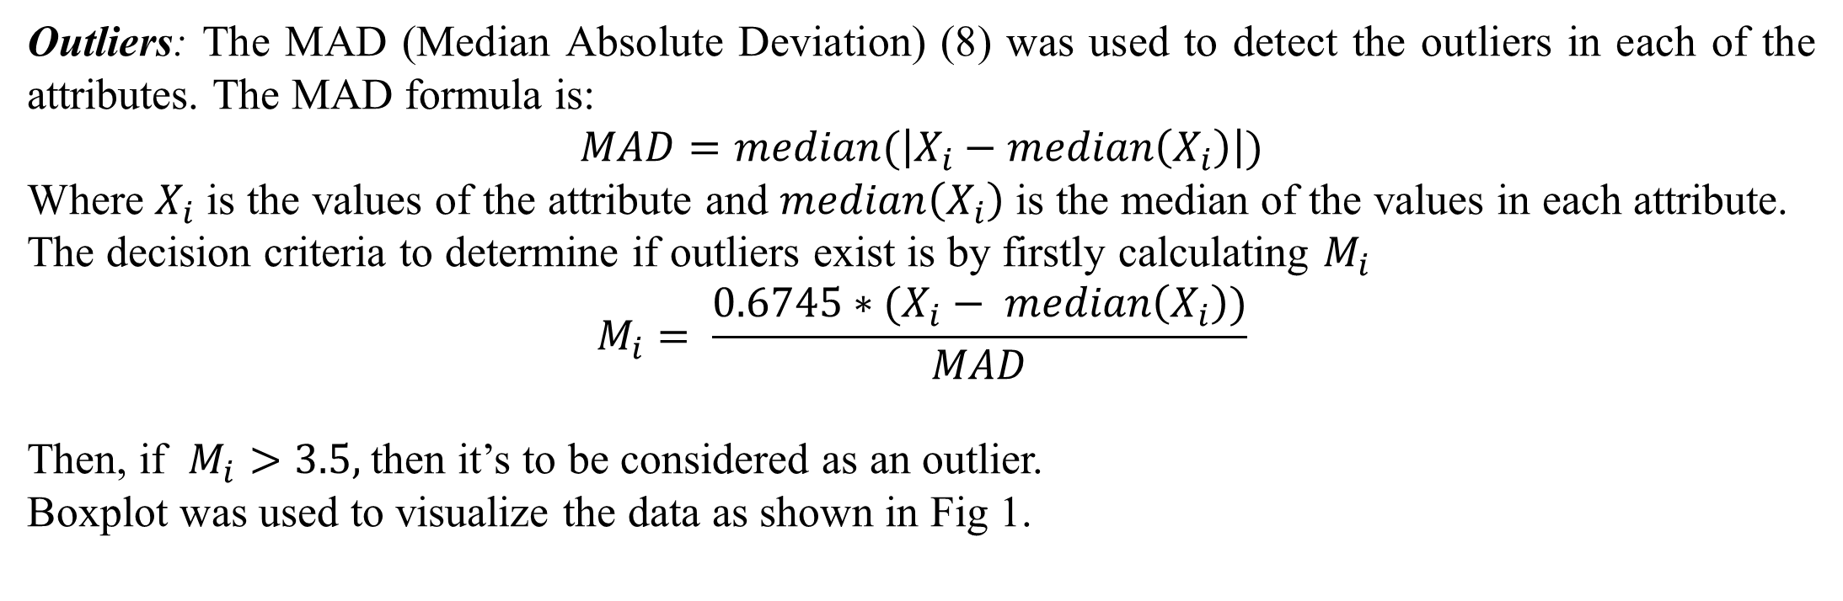
Investigation of Florida Housing Prices using Predictive Time Series Model
Temilola Aderibigbe and Hongmei Chi
temilola1.aderibigbe@famu.edu, hongmei.chi@famu.edu
Abstract
Outliers: The MAD (Median Absolute Deviation) (8) was used to detect the outliers in each of the attributes. The MAD formula is:
$$MAD=median(\left|X_{i}−median\left(X_{i}\right)\right|)$$
Where $X_{i}$ is the values of the attribute and $median\left(X_{i}\right)$ is the median of the values in each attribute.
The decision criteria to determine if outliers exist is by firstly calculating $M_{i}$
$$M_{i}= \frac{0.6745∗(X_{i}− median\left(X_{i}\right))}{MAD}$$
Then, if $M_{i}>3.5,$then it’s to be considered as an outlier.
Boxplot was used to visualize the data as shown in Fig 1.
Figure 3: House Price Index Prediction for the next 10 years: red represents actual values and blue is predicted values
In the ever-changing real estate market, there are certain factors that have a huge impact on the changing of prices, some small and there are relationships between those factors. The only way to understand the behavior of the changes would be to look at historical data of the factors and the housing prices. A lot of studies has been done over the years to predict the trends of the price, in various countries, using various statistical tools, data mining, and machine learning tools. Florida housing prices not only depend on genomics but also impact by hurricane strikes, even sea level rising. The project will involve the study of the housing market in Florida, we will be looking at the relationships between the price trend and volume of sales trend to the employment data, interest rate, GDP, inflation rate, hurricane strikes etc. Data from 1985 to 2016 will be using for our analysis and the data will be used to develop our model. We will be using the time series for the analysis to enable us to make the further prediction based on the behavior of the data, also decision tree model
Attribute | Wages | Employment | Number of Jobs | Per Capital Income | Home Owners | Labor Force | GDP | Population | Mortgage | Dow Open | Dow High | Dow Low | Dow Close | Dow Volume | Dow Adjust Close
Correlation coefficient | 0.8435 | 0.88 | 0.8839 | 0.8672 | 0.6305 | 0.8535 | 0.8852 | 0.8423 | -0.7269 | 0.7896 | 0.7865 | 0.7893 | 0.7871 | 0.7903 | 0.7871
Data
Table 2: Correlation coefficient between Housing price index and all the attributes
The first step was to identify factors that impact or are impacted by the housing price. The data collected were the House price index (HPI) in Florida [5], for all the counties, which is the primary attribute from January 1985 to December 2017 [6]. Mortgage rates for every month from April 1986 to September 2016, for 30 years fixed and 15 years fixed [1]. Employment data from the Bureau of Labor Statistics, the available labor in the state and the number of employed and unemployed in different fields, from January 1976 to December 2016 [2]. The Average Wage of employees in Florida and Total wage of employees in Florida from 1985 to 2017 [4]. The Gross Domestic Product of Florida from 1985 to 2016 [3]. The Total number of Jobs available in Florida gotten from [5], the labor force available, the number of people employed and the number of people unemployed. The data was from 1985 to 2017.
Method
Table 4: The error between the predicted values compared to the actual values
The overlay attributes Mortgage Rate, Employment, Sales, Dollar volume, Dow open and Dow close.
Confidence interval for forecasting – 95%, predictions were made 5 and 10 steps ahead for comparison.
The Poly Kernel is defined as where x and y are vectors in the input space c ≥ 0 is a free parameter trading off the influence of higher-order versus lower-order terms in the polynomial. When c = 0, the kernel is called homogeneous, d is the degree of the polynomial.
Regression optimizer determines the relationship between the variables using Sequential Minimal Optimization (SMO) algorithm.
Date |  | 2010 | 2011 | 2012 | 2013 | 2014 | 2015 | 2016
HPI | Actual | 294.8825 | 272.4725 | 270.82 | 292.8375 | 320.6725 | 350.82 | 384.705
 | Predicted | 295.3434 | 271.9953 | 270.1656 | 293.3471 | 321.2518 | 350.5754 | 384.2268
Percentage error |  | 0.4609 | -0.4772 | -0.6544 | 0.5096 | 0.5793 | -0.2446 | -0.4782
Data Visualization
Discussion
Date | HPI | Average Wage | Wages and Salaries | Number of Jobs | Employment | Labor Force | Population | Home Owner | Per Capital Personal Income | Mortgage rates | Dow Jones Index |  |  |  |  |  | GDP
 |  |  |  |  |  |  |  |  |  | 30 Year FRM | Open | High | Low | Close | Adj Close | Volume | 170894
1985 | 129.2325 | 17092 | 81955762 | 5771943 | 5023378 | 5342656 | 11366000 | 67.2 | 15006.5342 | 12.4301923 | 1322.835 | 1366.63418 | 1297.8675 | 1345.80752 | 1345.80752 | 217838333 | 185852
1986 | 135.0175 | 17899 | 89090619 | 6015226 | 5267509 | 5590997 | 11675000 | 66.5 | 15790.0511 | 10.1873077 | 1785.105 | 1867.47665 | 1719.85332 | 1815.09915 | 1815.09915 | 351650000 | 204816
1987 | 139.03 | 18872 | 98507639 | 6093623 | 5549518 | 5859869 | 12023000 | 66.3 | 16620.1778 | 10.2133962 | 2267.48751 | 2407.97585 | 2116.84835 | 2273.36586 | 2273.36586 | 504323333 | 224848
1988 | 144.8725 | 19775 | 107521864 | 6390284 | 5744058 | 6054325 | 12377000 | 64.9 | 17772.0508 | 10.3417308 | 2059.39916 | 2138.58753 | 1982.0925 | 2077.34 | 2077.34 | 389511667 | 241633
1989 | 150.485 | 20385 | 114922245 | 6596287 | 5890508 | 6237743 | 12671000 | 64.4 | 19318.7633 | 10.3194231 | 2486.19334 | 2589.7925 | 2404.86916 | 2535.72001 | 2535.72001 | 423612500 | 170894
TOOL
Using WEKA, we were able to create a support vector machine for Regression model. Table 1 shows the actual house price index for Florida compared with the house price index that was predicted using the WEKA from 2010 to 2016.
We noticed the Housing Price Index started to dropping in the year 2008 and It was the time when the market crashed in 2008 (6) .
During the computation, the error ranged from (-0.7, 0.7), which signifies a low percent error and the graph shown in Figure 2 shows that there is little difference between the actual and the predicted value.
Then, we went ahead and compute the prediction of Florida’s House Price Index for the next 10 years starting from 2018 as shown in Figure 3.
The tools used for the analysis are WEKA and R.
WEKA (Waikato Environment for Knowledge Learning) is a data mining software in Java, which is a collection of machine learning algorithms for data mining tasks. The algorithms can either be applied directly to a dataset or called from your own Java code. WEKA contains tools for data pre-processing, classification, regression, clustering, association rules, and visualization. It is also well-suited for developing new machine learning schemes. [7]. WEKA will also be used to create a time series model to be used for further predictions.
R is a system for statistical computation and graphics. It consists of a language plus a run-time environment with graphics, a debugger, access to certain system functions, and the ability to run programs stored in script files. [9]
Table 1: Primary attributes selected
Conclusion and Future Work
Model
The goal of this poster is to predict Florida’s House Price Index for the coming year using a predictive time series model. We were able to compute a model using training data from 1985 to 2016 and use the model to predict the prices for 2018 to 2022 and then increase the prediction for the next 20 years. From the prediction, we were able to observe see that Florida House Price Index will on an increase but reduces between 2023 and 2025 and have a dip in 2032.
Another vital factor that is to be consider while studying the behavior of housing prices in Florida is the rate natural disasters occur in Florida. We will be considering the effect of these disasters such as Hurricane etc. on the housing prices in Florida, modifying the model to accommodate the new factor. Also we will be looking to at dataset from other states than Florida, we would to test our model and make a comparison with other machine learning methods via timing and accuracy.
There are two methods, of Time series analysis, frequency-domain methods and time-domain methods. Here time domain method would be used which includes autocorrelation and cross-correlation analysis. The time series can be divided into the parametric and non-parametric approach and here focus would be on the parametric approach, assuming that most if not all of the parameters can be identified [7,8].
Figure 1: The independent attributes plotted against the dependent attribute Housing Price Index
Results
Data Preprocessing
Year | 2003 | 2004 | 2005 | 2006 | 2007 | 2008 | 2009 | 2010 | 2011 | 2012 | 2013 | 2014 | 2015 | 2016
Actual Value | 278.58 | 326.3775 | 410.0025 | 474.915 | 462.5875 | 383.705 | 327 | 294.8825 | 272.4725 | 270.82 | 292.8375 | 320.6725 | 350.82 | 384.705
Predicted Value | 277.7383 | 327.2764 | 409.3357 | 471.4678 | 461.6289 | 385.3427 | 328.043 | 295.3814 | 272.982 | 271.0054 | 293.2393 | 322.2618 | 350.744 | 384.4512
Data Cleaning: The tables were checked for incomplete, inconsistent, noisy data. Since the data are from different sources, some tables provided monthly data while others were annual. Few data range from 1975 to 2017 and majority were from 1985 to 2016. Data integration process steps were taken so that all the data were available for the given periods. All the data for the years preceding 1985 from other tables were ignored, and the quarterly and monthly data were transformed to yearly data by computing their average.
Data Correlation: The correlation between each of the attributes and the primary attributes were compared and the attributes with the highest correlation were chosen for the analysis. The correlation was calculated using the Pearson correlation test [10] in R studio. The figure above shows the relationship between five of the attribute with the primary attributes. The data with a correlation coefficient between the open interval (-0.5,0.5) were classified to have less correlation and were ignored from the analysis.
References
Table 3: The predicted values compared to the actual values
Mortgage rates http://www.hsh.com/monthly-mortgage-rates.html
Employment Data from the Berea of Labor http://www.hsh.com/monthly-mortgage-rates.html
Gross domestic product (GDP) by state (millions of current dollars) https://www.bea.gov/iTable/iTable.cfm?reqid=70&step=10
Average wages and salaries (dollars) https://www.bea.gov/iTable/iTableHtml.cfm?reqid=70&step=30
Staff, Investopedia. “House Price Index.” Investopedia, Investopedia, 19 Apr. 2018, www.investopedia.com/terms/h/house-price-index-hpi.asp
All-Transactions House Price Index for Florida https://www.fhfa.gov/DataTools/Downloads/Pages/House-Price-Index-Datasets.aspx#qat
Weka 3: Data Mining Software in Java http://www.cs.waikato.ac.nz/~ml/weka/
https://en.wikipedia.org/wiki/Time_series#Methods_for_analysis
https://www.r-project.org
Pearson Product-Moment Correlation. (n.d.). Retrieved April 20, 2018, from https://statistics.laerd.com/statistical-guides/pearson-correlation-coefficient-statistical-guide.php
Figure 2: A bar chart showing the relationship between the actual House Price Index and Predicted House Price Index

